Slide 1



Course Name: Design Thinking
Course Code: HSMC-101
Lecture No: 1
Topic: Introduction to Design Thinking
Faculty: Mr.Sunil Kumar
Model Institute of Engineering & Technology
Notes:
Presentation slide for courses, classes, lectures et al.

Slide 2
Course Outcomes
Course Outcomes | Description | Mapping with Program Outcomes and Program Specific Outcomes
CO1 | Develop a strong understanding of the design process and how it can be applied in a variety of business settings. | 1,2,3,4
CO2 | Understand the unique needs of the company around specific challenges | 1,2,3
CO3 | Apply design thinking framework and strategies to develop innovative solutions for complex business problems | 1,2,3,4
CO4 | Evaluate the financial viability of a new product or service ‘the design thinking way’ | 1,3,4,5, 11
CO5 | Work in a team to visualize and design a possible new product or service to assess the market, business and technical merits of the concept. | 1,2,3,4,9 11
Notes:
This slide will capture the d

Slide 3
Outcomes of Today’s Lecture
1. To understand the concept of design thinking and its characteristics.
2. To understand the importance of design thinking for companies.

Slide 4
Design Thinking
Design Thinking is simply a method for creative problem solving.
“Design Thinking is an iterative process in which we seek to understand the user, challenge assumptions, and redefine problems in an attempt to identify alternative strategies and solutions”

Slide 5
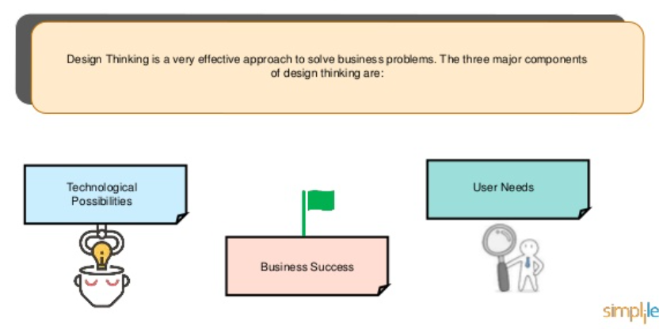

Components of Design Thinking

Slide 6
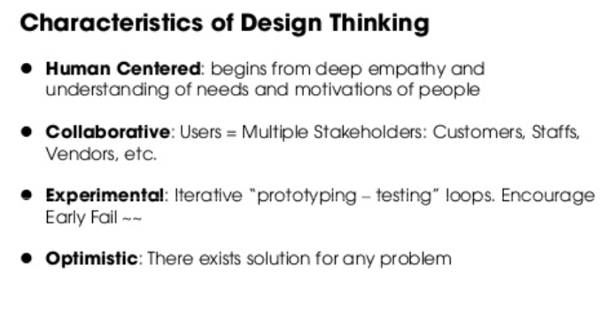
Importance of the Design Thinking
Notes:
https://www.slideshare.net/meslab/design-thinking-1-42292597/17

Slide 7
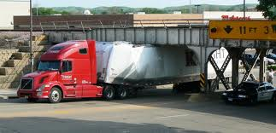
An Example of Problem solving: The Learned Vs. The Fresh Mind
Some years ago, an incident occurred where a truck driver tried to pass under a low bridge. But he failed, and the truck was lodged firmly under the bridge. The driver was unable to continue driving through or reverse out.
The story goes that as the truck became stuck, it caused massive traffic problems, which resulted in emergency personnel, engineers, firefighters and truck drivers gathering to devise and negotiate various solutions for dislodging the trapped vehicle.
Emergency workers were debating whether to dismantle parts of the truck or chip away at parts of the bridge. Each spoke of a solution which fitted within his or her respective level of expertise.

Slide 8
Contd…
A boy walking by and witnessing the intense debate looked at the truck, at the bridge, then looked at the road and said nonchalantly, "Why not just let the air out of the tires?" to the absolute amazement of all the specialists and experts trying to unpick the problem.
When the solution was tested, the truck was able to drive free with ease, having suffered only the damage caused by its initial attempt to pass underneath the bridge. The story symbolizes the struggles we face where oftentimes the most obvious solutions are the ones hardest to come by because of the self-imposed constraints we work within.

Slide 9
History of Design Thinking
Developing creativity techniques in the 1950s and new design methods in the 1960s led to the idea of design thinking as a particular approach to creatively solving problems.
Among the first authors to write about design thinking were John E. Arnold in "Creative Engineering" (1959) and L. Bruce Archer in "Systematic Method for Designers" (1965).

Slide 10
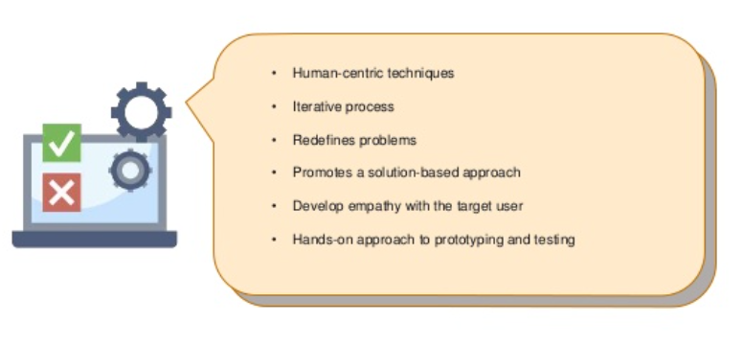
Why design thinking is important?

Slide 11
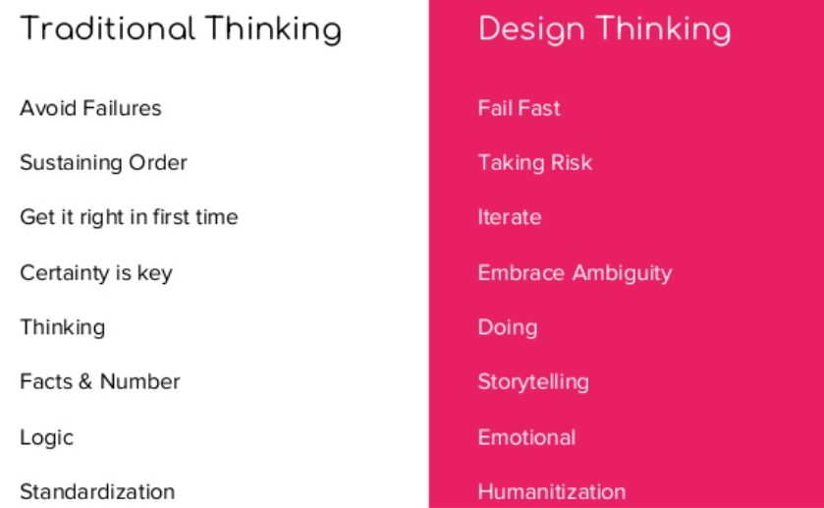
Difference between Traditional & Design thinking

Slide 12

Example of design thinking

Slide 13

Elements of Design thinking

Slide 14

Elements of Design thinking

Slide 15

Example of Design Thinking

Slide 16
Class room problem
Identify the class room problem!

